Slide 1
35104: Mind the App
Application Development as a Solution to Unmet Needs in Laboratory Workflows
Amrom Obstfeld MD PhD
Daniel Holmes MD, FRCPC
Stephan Kadauke MD, PhD
Notes:
Hello and welcome everyone to session 35104: Mind the App
Application Development as a Solution to Unmet Needs in Laboratory Workflows
Before I begin I just want to thank the conference organizers for giving us the opportunity to share some of our work, and thanks to the education team at AACC for the tremendous amount of work that went into making this a smooth experience.
2021 AACC Annual - Remote Moderator and Speaker
Show Zoom Link 9/26/2021-9/30/2021
https://onlineevent.zoom.us/j/98683957876?pwd=R0ZMeEFYSjJQbWFSZURvVEVESGc2QT09
Meeting ID: 98683957876
Passcode: 545311

Slide 2

Amrom Obstfeld, MD, PhD
Director, Pathology Informatics
Department of Pathology and Laboratory Medicine
Children's Hospital of Philadelphia
Notes:
I am your moderator today, My name is Amrom Obstfeld and I am Director of Pathology Informatics at Children's Hospital of Philadelphia

Slide 3
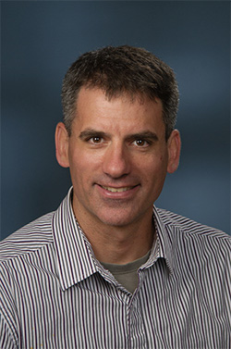
Dr. Daniel Holmes MD, FRCPC
Clinical Professor,
Division Head, Clinical Chemistry,
St. Paul’s Hospital
Notes:
With me today is dr. Dan Holmes
Clinical Professor,
Division Head, Clinical Chemistry,
St. Paul’s Hospital
as well asl

Slide 4

Stephan Kadauke, MD, PhD
Assistant Director, Cell and Gene Therapy Laboratory
Lead, CGT DataOps Team
Children's Hospital of Philadelphia
Notes:
Dr. Stephan Kadauke the Assistant Director of the Cell and Gene Therapy Lab and lead of the Cell and Gene Therapy Data Operations group at the Children’s Hospital of Philadelphia.
He also leads the Cell and Gene Therapy Data Operations group, which aims to improve the care of children who receive Bone Marrow Transplants and other Cell and Gene Therapies.
Dr. Kadauke developed a curriculum in Reproducible Clinical Data Analysis tailored for physicians and other healthcare professionals.

Slide 5
Outline
Why Custom App Development for Your Lab?
- Amrom Obstfeld MD PhD
Why Use R and What Kinds of Apps Can I Make?
- Daniel T Holmes MD, FRCPC
Making Reliable Lab Apps: Demystifying Good Software Engineering Practices
- Stephan Kadauke MD PhD
Notes:
And tbhis is the ourline of today's scientific session.
I will be introducing the subject by discussing why labs should even consider something so unlabby as developing clinical apps
Dr. Holmes will take over by introducing R and demonstrating some of the apps one can make with a little coding and elbow grease
And finally dr. Kadauke will describe some of the approaches he takes to make an app function as reliably as google.com

Slide 6
Why Custom App Development for Your Lab?
Amrom Obstfeld MD PhD
Directory, Pathology Informatics
Notes:
So with that I'm going to get started by framing the discussion and talking about why we think lab people should get involved in something like app development

Slide 7
Disclosures
None
Notes:
I have no relevant disclosures

Slide 8
Learning Objectives
Explain the benefits provided by investing in custom app development
List challenges associated with using custom applications in clinical workflows
Describe what practices can be implemented to mitigate these challenges
Notes:
So here are the learning objectives for us, I hope by the end of the sessions you will be able to
Explain the benefits you might see for your lab by investing time and resources into custom app development
List some challenges associated with developing and using custom applications in clinical workflows
And finally describe what practices you might be able to implement to mitigate these challenges
But putting aside the formalities for just a moment I want to convince you of two things
One is that the we as laboratorians have a problem. Specifically that our lab systems are limited, and that these limitations are both features and bugs of technologies in healthcare and in fact everywhere. BUT its not all bad, the SECOND thing I want to persuade you of is
That each and everyone of us can actually do something about it, were not talking about moving mountains, and my colleagues Dr. Holmes and Dr. Kadauke will explain and demonstrate how laboratorians can implement these solutions

Slide 9
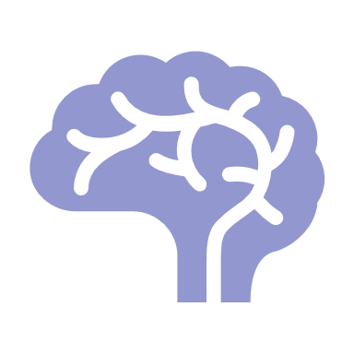
The Brain of the Modern Clinical Laboratory
Accession
Quality Control
Orders
Asset tracking
LIS
Results
Automation
Test Dictionary
Instrument Driver
Notes:
So in many ways our lab systems are the central nervous system of the modern laboratory storing and retrieving data, reflexing actions and triggering activities throughout the lab.
→ There is virtually no activity in our labs that does not in some way interface with the LIS, including some that I've listed here, such as Accessioning Orders, result verification, and test setup.

Slide 10
The Brain of the Modern Clinical Laboratory
Accession
Peopleware
Quality Control
Orders
Instruments
Middleware
Asset tracking
LIS
Results
Automation
Test Dictionary
Instrument Driver
Notes:
But by the same token the LIS is really just one elemnt of a larger network of systems that all seamlessly work together to make our labs work, including middleware systems that bridge between our LIS and instruments, and then of course what you might call the peopleware – our staff and operations folks who interact with all these systems, seamlessly coordinating all their activities.

Slide 11
The Brain of the Modern Clinical Laboratory
Accession
Accession
Quality Control
Orders
Quality Control
Orders
Instruments
Middleware
Asset tracking
LIS
Results
Asset tracking
LIS
Results
Automation
Test Dictionary
Instrument Driver
Automation
Test Dictionary
Instrument Driver
Notes:
Problems though begin when these interactions are not so seamless. Gaps inevitably arise between these concentric circles of systems. The consequence of this is greater need for workarounds, erors, safety events, and a more general degradation in the overall quality of the work being done in the lab.

Slide 12




Why do these gaps arise?
Interfaces lead to "language barriers"
LIS are designed for the 80%
Specialty labs not compatible with LIS design
?
No useful lab system available
Notes:
So why does this occur? Why can't we get the pieces of this system to line up as needed?
Well there are many reasons but I'd like to highlight for you all just a few.
→First is because of the complex technology landscape we live with in healthcare. Analyzers have software that send information to middleware-and-lab systems which then transmit results over to the electronic health record. Each one of these systems is like its own fiefdom. The way information gets from one to the other is through what are called interfaces, which not only send bytes of data but also actually translate messages so they can be understood on the receiving end and problems arise when messages are lost in translation.
For instance I remember a time when weeks after implementing a new lab system we discovered that the critical values in the EHR were not marked with an exclamation point but with some generic symbol because the new lab system was marking those results with a character that the EHR just didn't understand, and that was particularly bad because physicians in my hospital are trained just to look for those abnormal and critical flags so the likelihood is that this is something that was missed.
Second its important to realize that LISs are created to work with most labs, but almost all labs will have specific ways that they are not like most labs. This could be because of a unique patient population in the hospital, or maybe a specific type of clinical practice.
Third, specialty labs such as molecular labs or mass spec labs are going to have their own issues. Lab systems generally are made to be compatible with core lab, micro, blood bank and AP workflows. So these labs may have a hard time translating their processes to work with the lab system, its sort of a a round peg square hole problem
Finally, occasionally there is just no usable lab system available at all. this is not so common any more but in some estoeric testing environments this can be a significant issue. I personally have seen this in cell therapy labs or in some hybrid research clinical labs.

Slide 13
Closing the Technology Gap
Accession
Accession
Accession
Quality Control
Orders
Quality Control
Orders
Quality Control
Orders
Instruments
Middleware
Asset tracking
Results
Asset tracking
Results
LIS
LIS
Asset tracking
LIS
Results
Automation
Test Dictionary
Automation
Test Dictionary
Automation
Test Dictionary
Hire staff
Technology
Do Nothing
Instrument Driver
Instrument Driver
Instrument Driver
Notes:
So what are out options.
Well certainly you could do nothing. DOIng nothing has worked so far so why not keep going. Well that can work sometimes but as we've saif these problems can cause workarounds, erors, safety events, and my chair is not the kind of person who would brush aside a preventable event that occurred because we didn’t fix a workflow.
→You could hire more staff, institute checks, paper process, but good like hiring new techs in these times.
Or you could try to fix a technology issue with
→ more technology! And as I ironic as it sounds this is the preferred option, why? because technology comes with a lot of benefits! Specifically when you have a technically based solution you have an opportunity for automation, and that means less work for the lab, faster turnaround times, AND reproducibility – which means that someone can use the same system you did and come up with the same result.

Slide 14
vs
Technology
Buy
Build
Functionality gap is remedied by off the shelf solution from 3rd party vendor or LIS vendor
Lab produces a custom home-grown app or system to meet workflow needs
Notes:
The conventional way we've handled these situations is by buying software. You ask colleagues what system they use, you go through a RFI process and you buy the system that seems to fit best.
→ BUT there is another option that is not taken seriously enough, and that is to build our own solution. But why would anyone do that right? darn it we’re doctors not programmers!

Slide 15
vs
Buy
Build
Well supported off the shelf solution without the need for ongoing lab support
Custom solution with potential to grow with the laboratory
Strengths
Contracting
New systems can have gaps too
• Not customizable
Weakness
Coding not a common skillset in laboratory personnel
"Risky" lab owns the continued maintenance
Notes:
Well it does depend on the circumstance but I would argue that weighing the pros and cons things look pretty good for the "Build" approach when you lay it out.
Its true when you buy software you should be getting well supported off the shelf solution without the need for ongoing lab support but that advantage comes at price:
→ Contracting can take a long time,
Any new system can have gaps just like the first system does and
These software tend to be pretty rigid and not customizable
But let's re-examine the strengths that we have here….

Slide 16
Buy
Strengths
Well-supported
off the shelf solution without the need for ongoing lab support
But for how long??
Well-supported
Except for build, configuration…
off the shelf solution
Notes:
Its true that well run software companies will have made investments in support to make sure that the application is running as needed, but at the same time,
→ many software companies are not well run, and how long after signing contract will they put your requests in line with everyone else's? I've certainly been in situations where my lab found a software vendor completely irresponsible when it came to their obligations…
→ And also these applications may seem like they are just plug and play, companies will say the software can handle any use case you throw at it, but those features can take a long time to implement, so in the end its almost like you're developing their software for them.

Slide 17
vs
Buy
Build
Well supported off the shelf solution without the need for ongoing lab support
Fit for purpose custom solution with potential to grow with the laboratory
Strengths
Contracting
New systems can have gaps too
• Not customizable
Weakness
Coding not a common skillset in laboratory personnel
"Risky" lab owns the continued maintenance
Notes:
OK so maybe the benefits of buying aren't as great as they first seem, what about the build side of the equation??
Well when you make your own app you get a much better fit with your own specific environment because you're not trying to make something that’s going to work in all labs, it’s a specific solution. That is a huge advantage
But of course there are disadvantages too
→ Chief among them is the I'm a doctor not a programmer issue. Coding is not on the job ads that I've seen for most pathology or lab positions.
PLUS And this may be of even more importance, what kind of Risks are involved in making these apps, what kind of support is the app gionng to need long term?

Slide 18
Weakness
Build
Open-Source
Coding not a common skillset in laboratory personnel
"Risky" lab owns the continued maintenance
Coding not a common skillset in laboratory personnel
Notes:
And these are important issues – but there are also ways to mitigate these issues.
→ So firstly – for people who are not technical, coding might seem like a bridge too far. BUT The first resource to be aware of is the availability of something called open source tools. So what is open source?

Slide 19
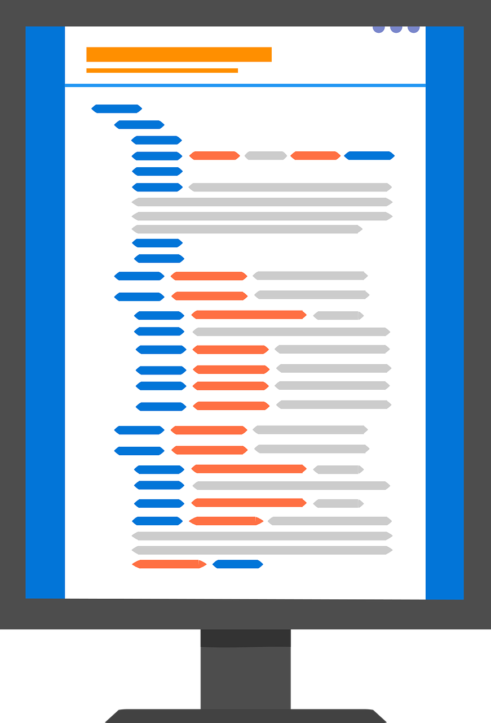


Open-Source
Freely available
Source code is distributed with program
Free to share
Anyone can share with anyone else
Free to modify
Users can make changes as needed
Free to improve
New features can be added and distributed
Notes:
Open source tools and software can is defined in a variety of different ways but more or less it means that the
The code running the software is available for free
That anyone can modify that code and make it work how they want
That it can be shared freely
And finally that it can be build upon and improved as the user wants
So who cares? Well open source is an incredible enabler…

Slide 20
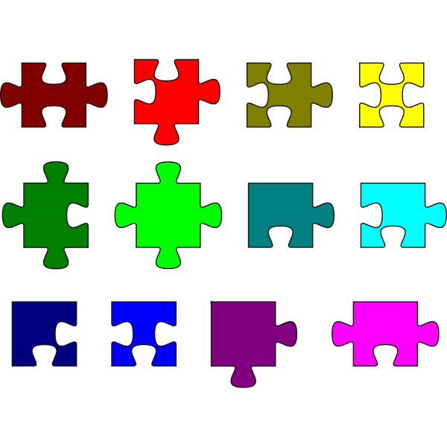
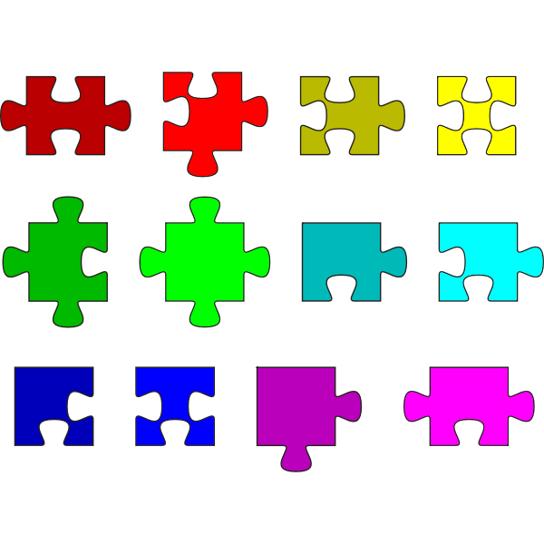
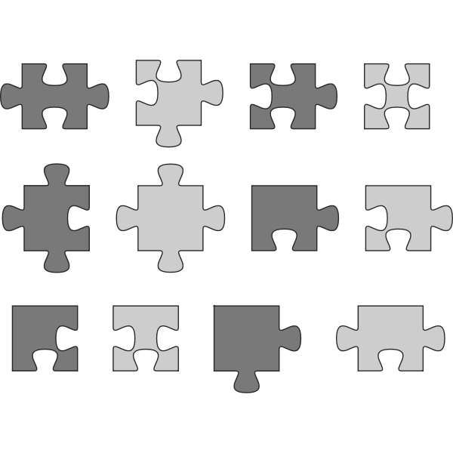
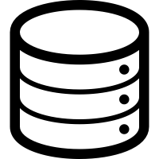


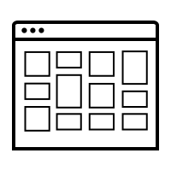

Open-Source
Stand on the shoulders of giants
Customizable
Community
Notes:
By using open source you can piece together different packages and tools. For instance if you want to make an app that involves having a website, a database, a server, and some interactivity, like a puzzle or legos you're piecing packages together - building something more complicated from pieces that have been created for you, refined by people with more expertise than you, and made publicly available.
This is the "standing on shoulders of giants" benefit
→

Slide 21
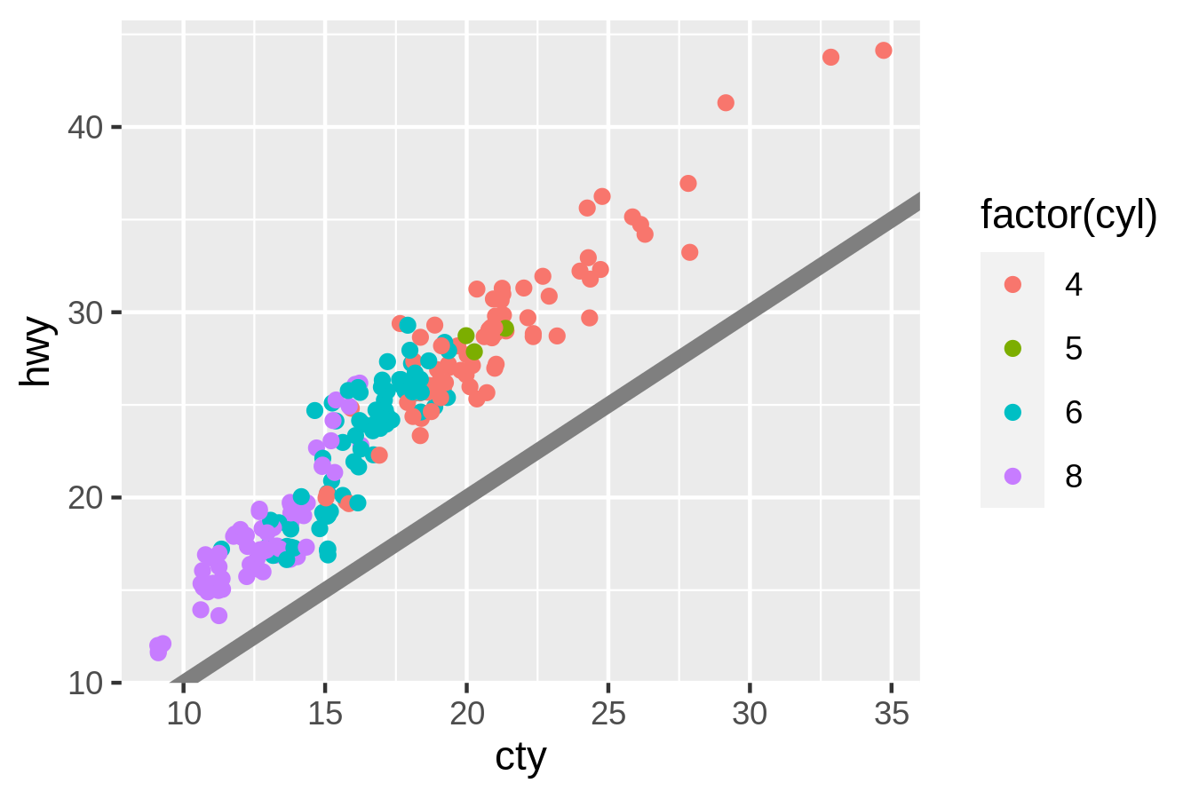
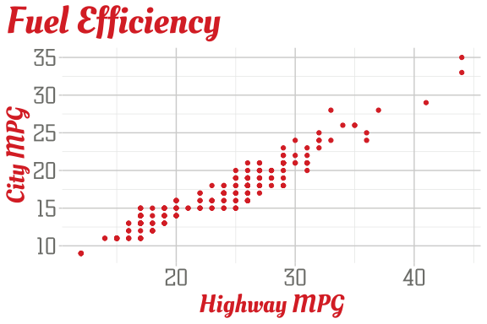
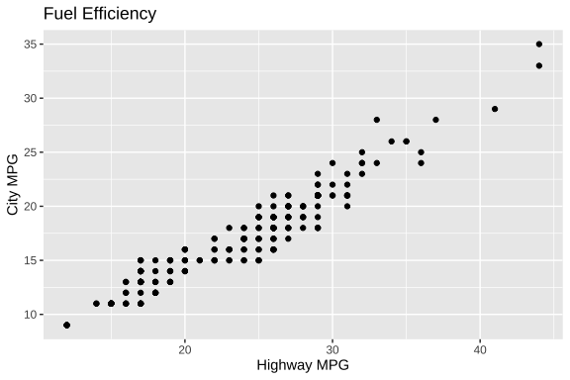
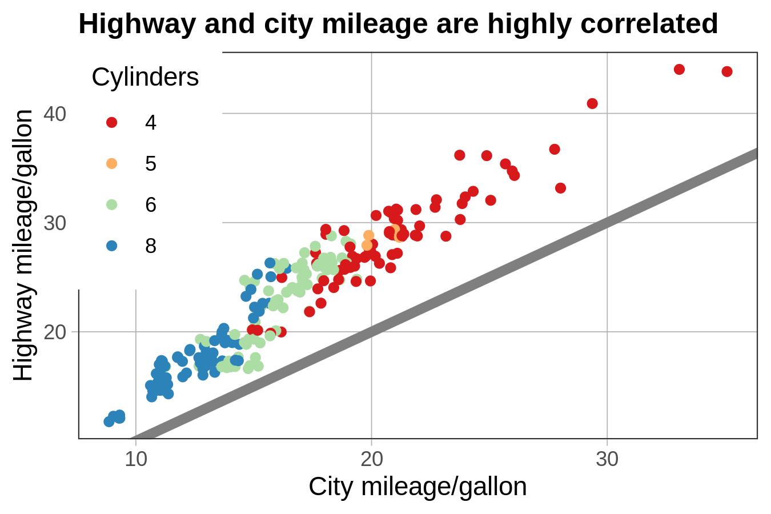
Open-Source
Stand on the shoulders of giants
Customizable
Community
Notes:
Next - After grabbing the pieces of software you can customize the look and feel and even function of the software so that it works for your own individual lab

Slide 22
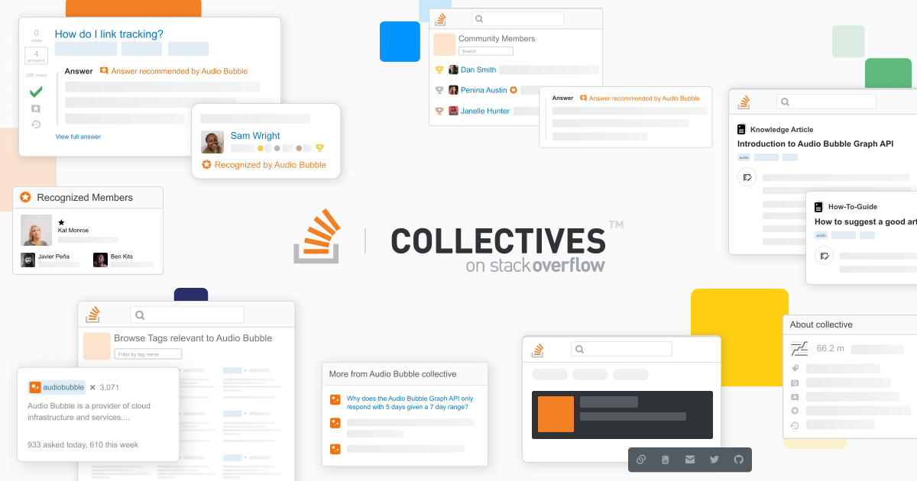
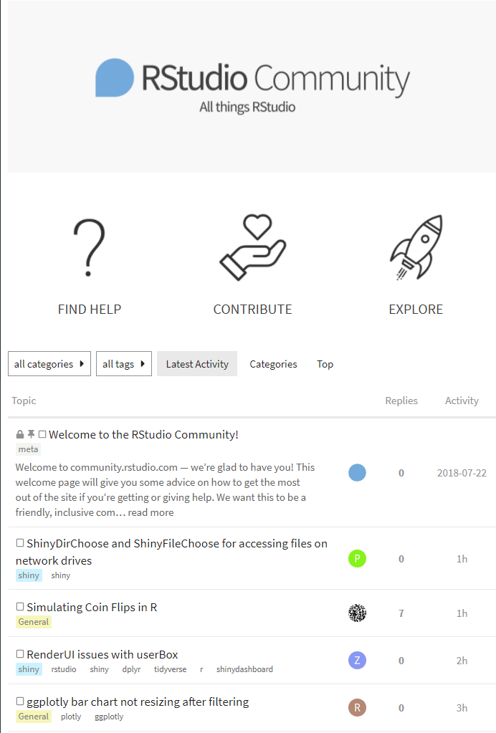
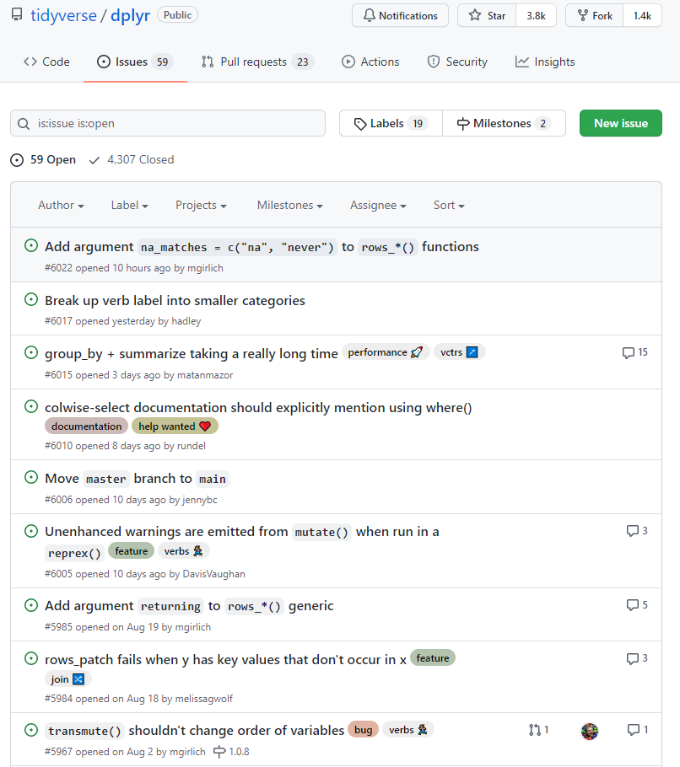
Open-Source
Stand on the shoulders of giants
Customizable
Community
Notes:
And finally because open source tools are shared freely on the internet there tends to be large communities of individuals who are sharing, exchanging and importantly helping each other with issues. so although you might think that professional support you get with proprietary software must be great because you paid for it, in fact with open source you can get any question answered with a quick google search because you have the wisdom of the crowd .
Dr. holmes in the next session will go into how he uses this paradigm at his lab.

Slide 23
Build
Open-Source
Coding not a common skillset in laboratory personnel
"Risky" lab owns the continued maintenance
Coding not a common skillset in laboratory personnel
Notes:
Fine so maybe the coding isn't going to be so hard, but isn't this all a little risky?

Slide 24
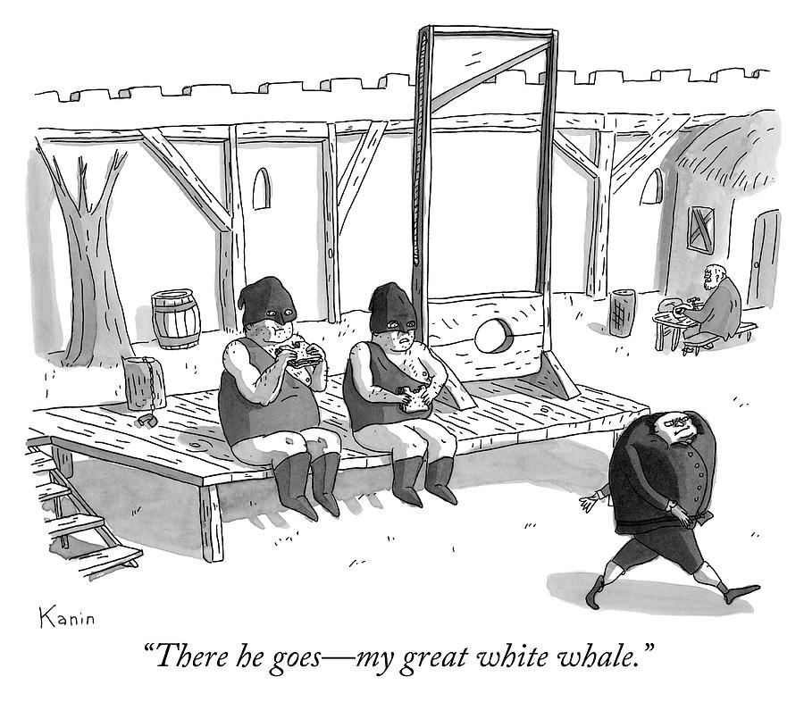
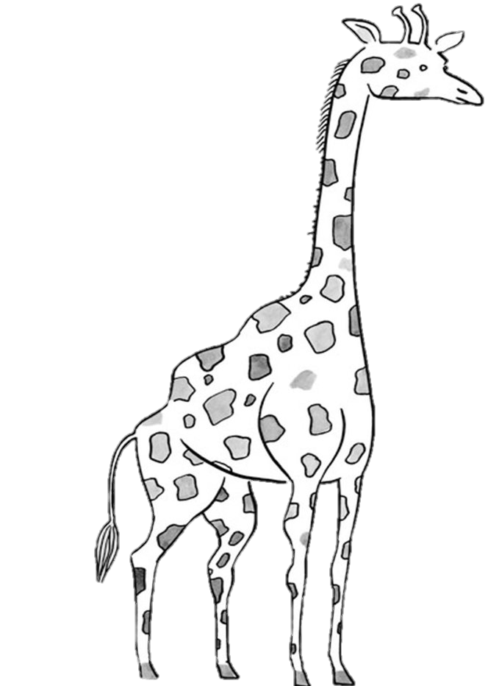
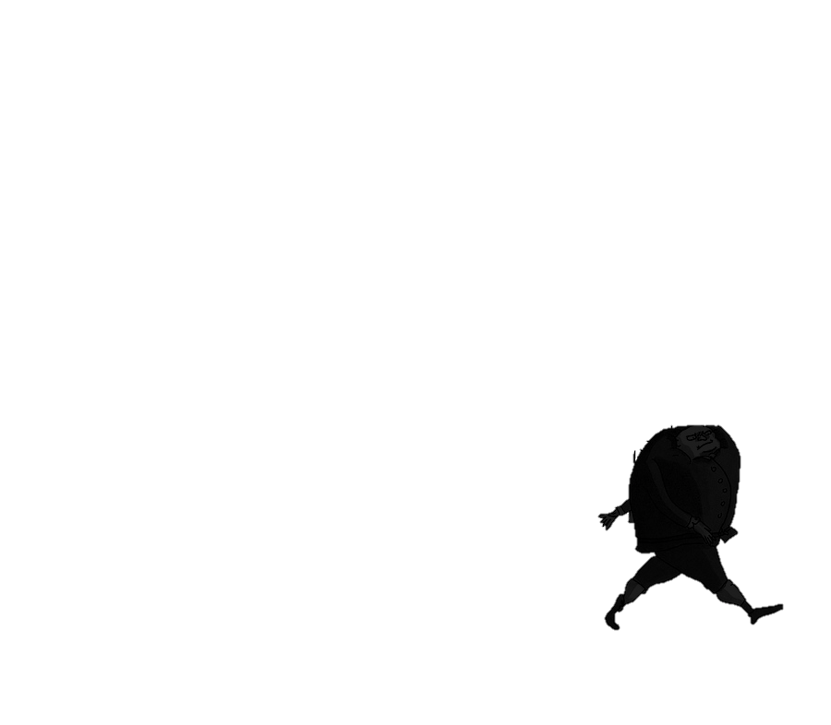
.
Notes:
Well as this guy on the lower right can tell you if you're not sticking your neck out you're not taking on much risk, but you're also not solving any problems either. The issue is that when you make a decision to improve the situation, you're more like this guy on the left ->
That's a bit more of a riskier proposition.

Slide 25
Weakness
Build
Open-Source
Coding not a common skillset in laboratory personnel
"Risky" lab owns the continued maintenance
Coding not a common skillset in laboratory personnel
"Risky" lab owns the continued maintenance
Software Engineering Practices
Notes:
But there is actually something you can do to reduce the amount of risk involved in making your own solutions
And the way to do that is by putting guardrails around the apps using a set of conventions that for now I'll call software engineering practices,
And Dr. Kadauke in his session will go into how one actually does that in real life.

Slide 26
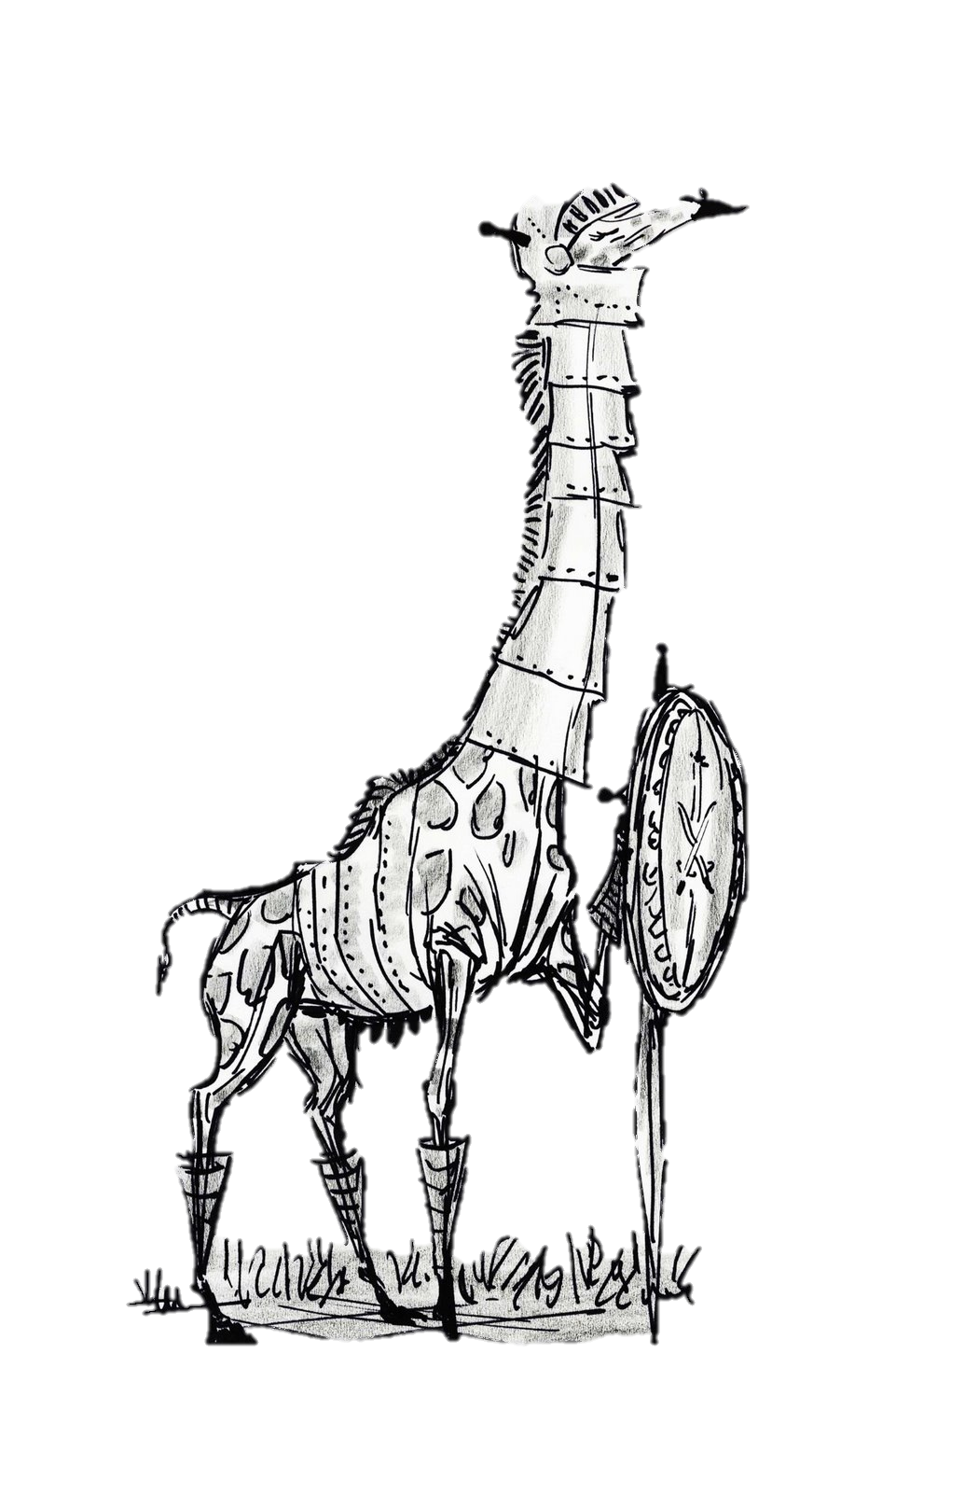
Software Engineering Practices
.
Notes:
Essentially what I'm talking about is reducing the vulnerability of things that you make, increasing their stability and resilience, so that the person offering solutions isn't put into a precarious situation just because they are fixing things.
So rather than just sticking your neck out like this giraffe
→ You're sticking your neck out with some assurance that you won't get hurt because of it

Slide 27
Summary
Design gaps are inevitable in lab applications
01
Labs can buy or build solutions for these gaps
02
Building is easier and safer than most labs realize
03
Notes:
So in summary what we've discussed is that
Design gaps are inevitable in lab applications
Labs can buy or build solutions which offer the benefits of automation and reproducibility
And finally Building is easier and safer than most labs realize
So now without further ado I will hand the mic over to Dr. Holmes who will describe how he has put some of this into practice.

